Slide 1

Exploratory Data Analysis of Jobs in Google
Group No. 8

Slide 2
Introduction
Google has a plethora of jobs openings and posting mentioned on their career website.
The dataset we are going to use is extracted from Kaggle and is characterized by various parameters like Title, Category, Location, Responsibilities, Minimum Qualifications and Preferred Qualifications.
This topic would help us gain insight into the fundamentals of Business Intelligence practices on a practical level and help us refine our job search approach based on the most popular/in-demand jobs in the IT industry.

Slide 3
Data Dictionary
Variables:
Title : Role/Designation performed by prospective Employees
Category : Category of Department for the corresponding Role (Title)
Location : Location of the Job Role (Title)
Responsibilities : Description of Job responsibilities
Minimum Qualification : Must have qualifications for the Role (Title)
Preferred Qualifications : Good to have qualifications for the Role (Title)
No. of Observations in Data Set : 1251

Slide 4
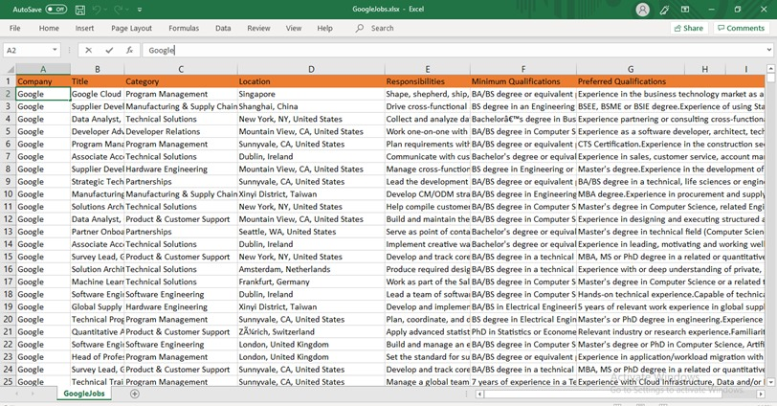
Snapshot of Data Set

Slide 5
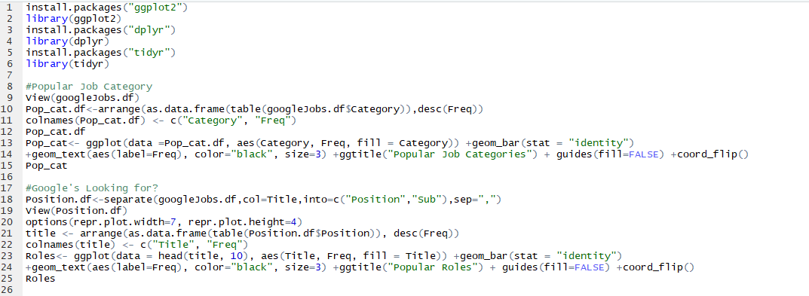
Popular Job Categories & Roles (Using R)

Slide 6
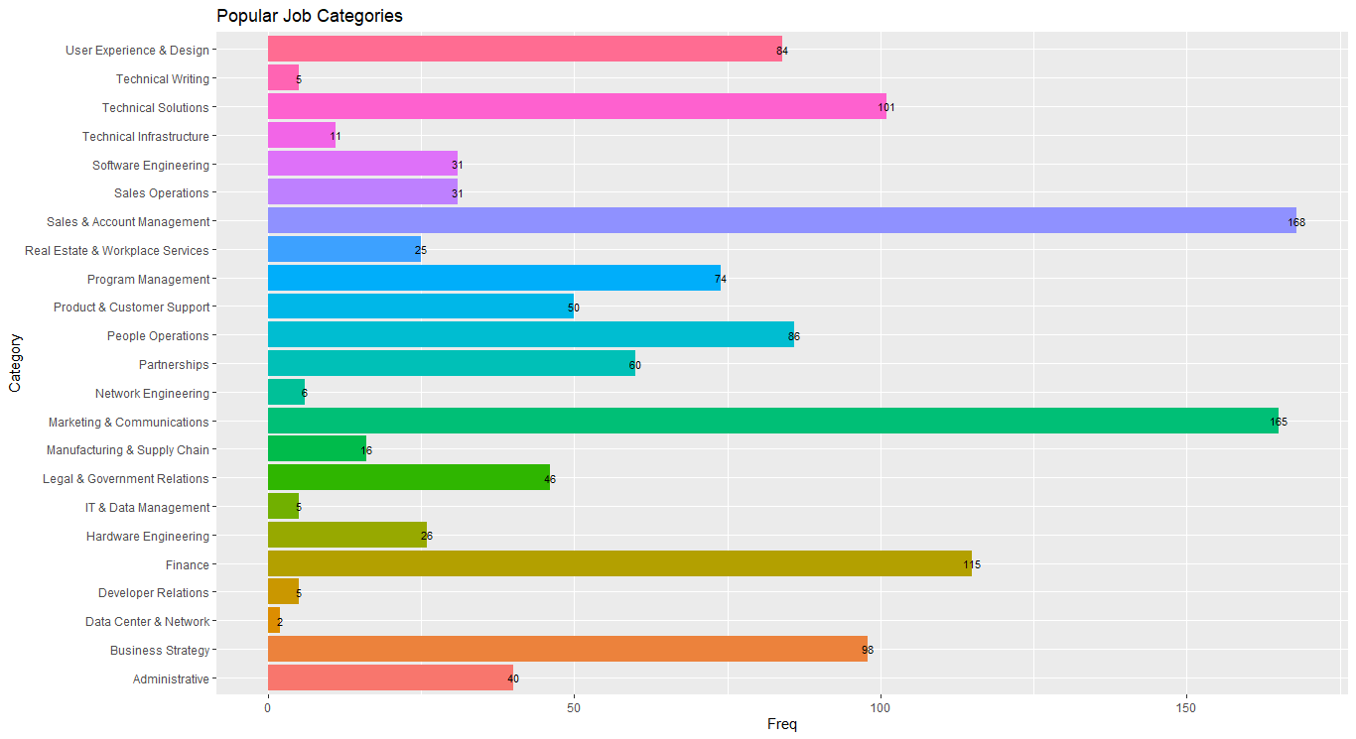
Popular Job Categories (Using R)

Slide 7
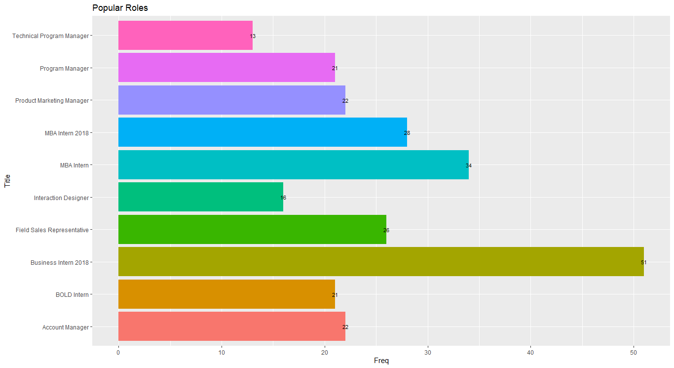
Popular Roles (Using R)

Slide 8
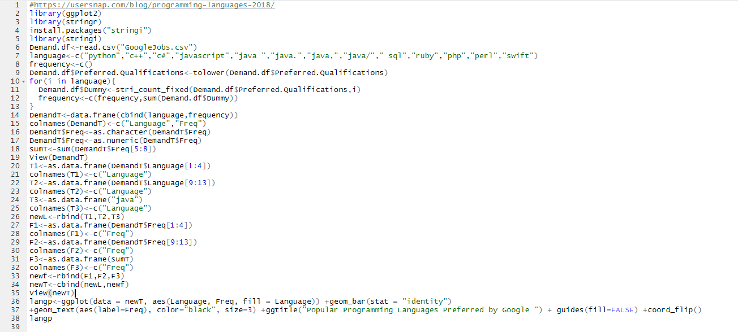
Popular Programming Languages (Using R)

Slide 9
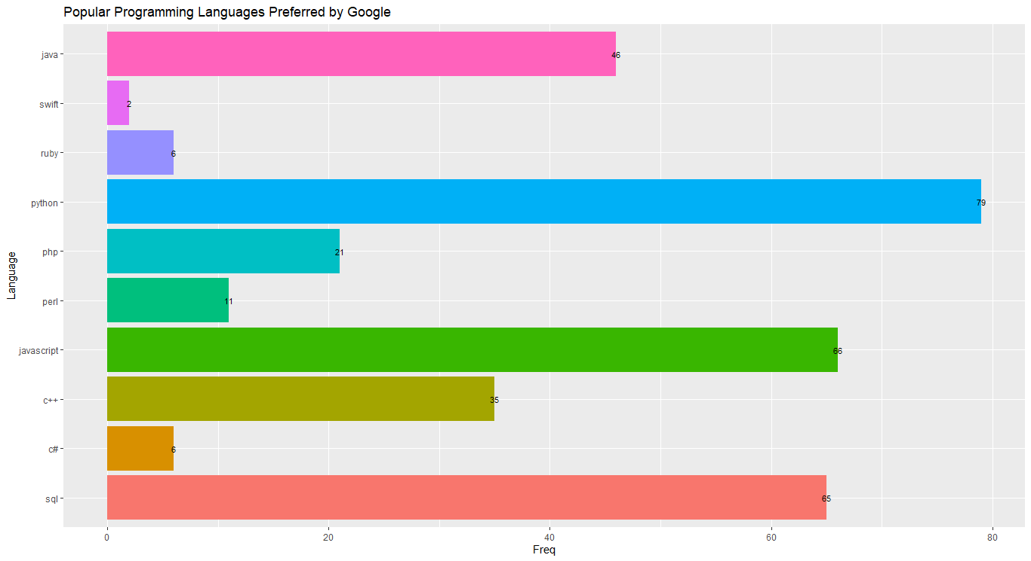
Popular Programming Languages (Using R)

Slide 10
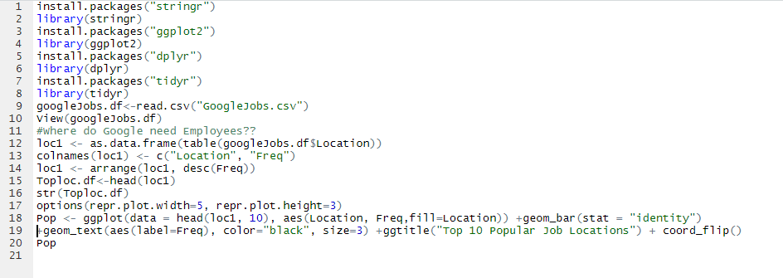
Top 10 Popular Job Locations

Slide 11
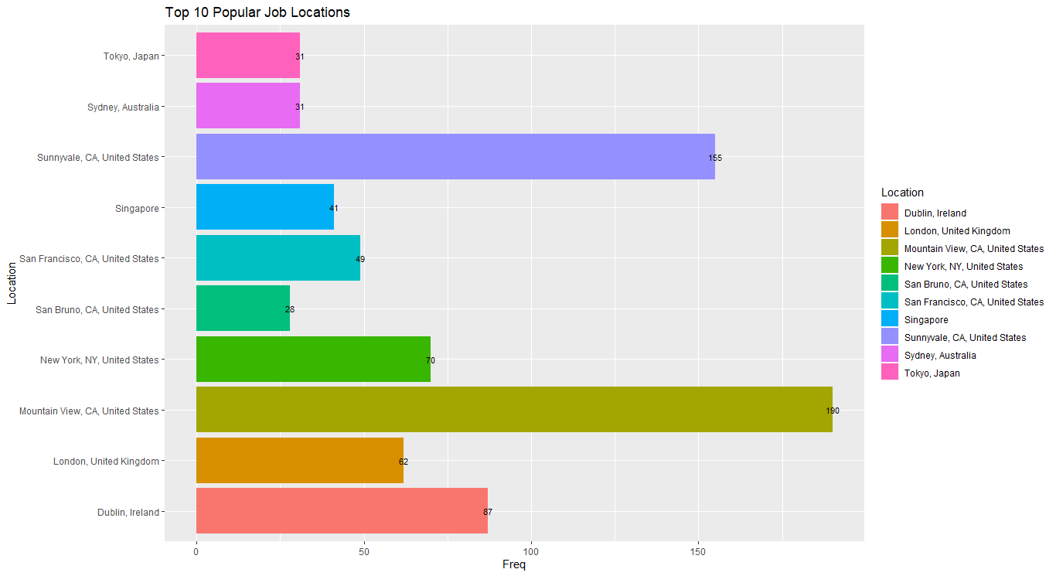
Top 10 Popular Job Locations

Slide 12
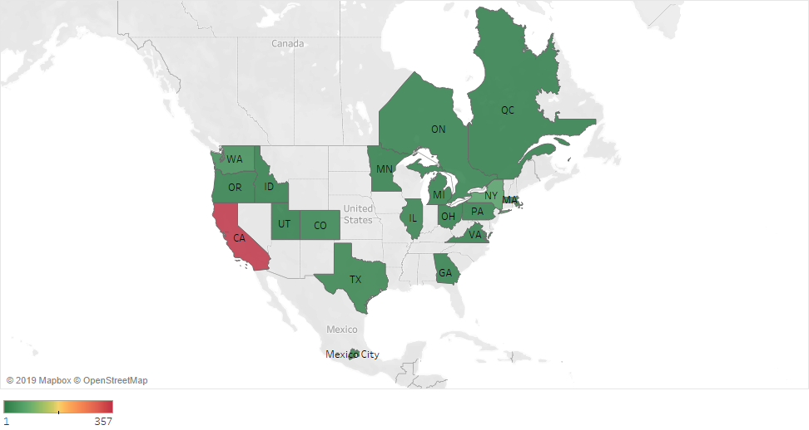
Job Openings US/Canada

Slide 13
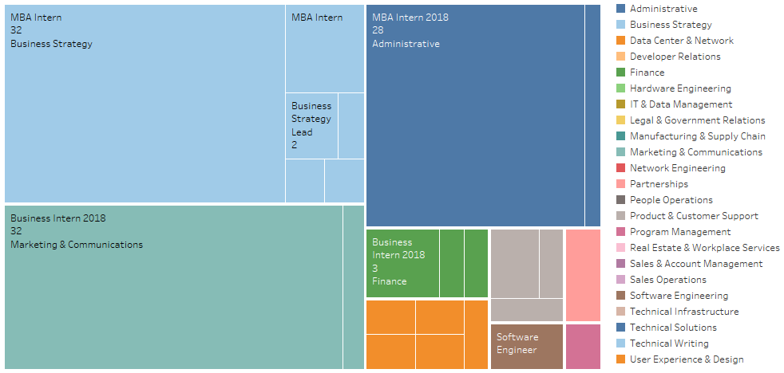
Jobs that require Masters degree (Number of Vacancies/Roles/Categories)

Slide 14
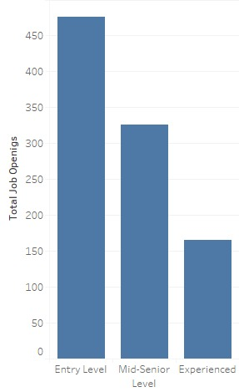
Job Opening (Experience-Wise)
Total job openings for
Entry Level position is 475
Mid senior Level position is 326
Experienced position is 165

Slide 15
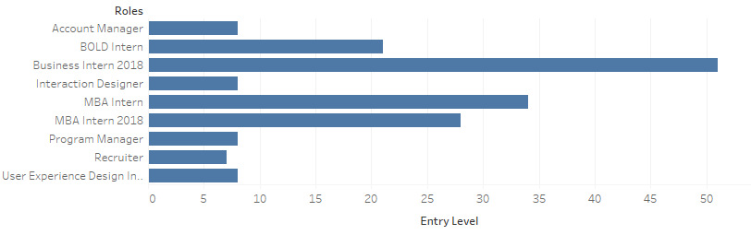
Entry Level Positions (TOP)

Slide 16
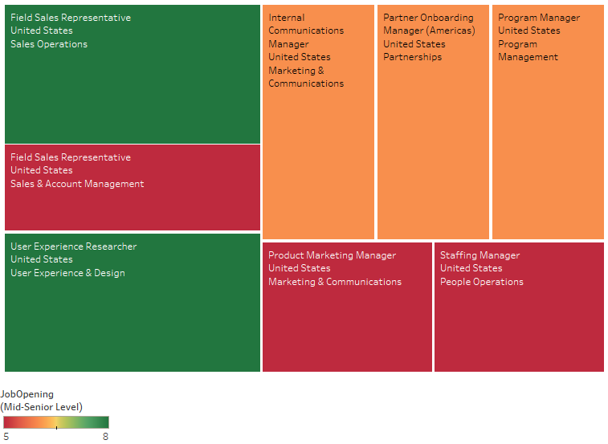
Mid-Senior Level Positions (TOP)

Slide 17

Takeaways
Data Exploratory Analysis (EDA) on acquired Data set (Text Mining, Implementing Delimiters for Comma-separated values, Data Binning)
Implementation of Business Intelligence tools (R Studio and Tableau)
Insights into Google’s hiring requirements based on various parameters (Title, Location, Qualifications, etc.)

Slide 18
Thank You

